Slide 1

DSA
Week 3
Big-O Notation
Data Structures and Algorithms (DSA)
Diploma in IT, CSF
Year 2 (2024/25), Semester 3
Last Update: 16 Oct 2024

Slide 2
Topics
Introduction to Asymptotic Analysis
Big-O Notation

Slide 3
1. Introduction to Asymptotic Analysis
In Data Structures and Algorithms, the efficiency can be measured in terms of:
Time Complexity
Space Complexity
Sometimes we need to seek a tradeoff between the two.
Complexity:
Rate at which the storage or time grows as a function of the problem size.
Complexity is dependent on several factors.
Machine used to execute the program, compiler used to construct the program, etc.
In DSA, we are interested in the inherent complexity of the program.

Slide 4
1. Introduction to Asymptotic Analysis
Asymptotic Analysis
As the problem size grows to infinity, the complexity can be expressed as a simple proportion to some known function.
Describes limiting behaviour
Allows for classification based on growth rates
Definition:
Given T(n) and f(n) are functions mapping non-negative integers to real numbers, we say that
T(n) = O(f(n))
if and only if there are constants c₀ and n₀ such that
T(n) <= c₀ f(n) for all n >= n₀ ( where c₀ > 0 and n₀ >= 1)
Read as "T of n is Big Oh of f of n.“
Big-O is sometimes known as an “upper bound” on the complexity.

Slide 5
1. Introduction to Asymptotic Analysis
T(n)
f(n)
Running time
input size n

Slide 6
1. Introduction to Asymptotic Analysis
There are other related notations: o, Ω, ω, and Θ to describe other types of bounds on the asymptotic growth rate

Slide 7
2. Big-O Notation
Definition:
T(n) = O(f(n))
if and only if there are constants c₀ and n₀ such that T(n) <= c₀ f(n) for all n >= n₀
Eventually, c₀ f(n) will exceed T(n) for some constant c₀
E.g., We can say n² + 2n = O(n²⁰), but we usually choose the limiting function f(n) to be as small as possible, i.e. n² + 2n = O(n²) as n² will dominate the growth as n increases.

Slide 8
2. Figuring out the Big-O Notation
Algorithm Analysis:
When figuring out the Big-O for a function or algorithm, simplify until you reach one of the terms in the function and that is the answer!
T(n) | Big-O?
3n + 4 | n
5n² + 6n + 9 | n²
14n³ + 17n | n³
30 log n + 4 n log n + 10 | n log n

Slide 9
2. Figuring out the Big-O Notation
Consider these three algorithms with their computation time T(n), how do they compare? Is the one with T(n) = 1000n² + 17n most expensive?
No! The first 2 algorithms are both in O(n²), and therefore are comparable. The 3rd algorithm is however O(n³), so it is the most costly!
(note that we are talking about large n in complexity considerations)
T(n) | Big-O
5n² + 6n + 9 | O(n²)
1000n² + 17n | O(n²)
2n³ + 5 | O(n³)

Slide 10
2. Big-O Notation: Common Functions
T(n) = O(1) constant growth
T(n) does not grow at all as a function of n, i.e., it is a constant.
E.g., array access is independent of size of the array
T(n) = O(n) linear growth
T(n) grows linearly or proportionally with n.
E.g., looping through all elements in a 1-D array
T(n) = O(n^{k}) polynomial growth
T(n) grows proportionally to the k-th power of n.
E.g. selection sort algorithm is O(n²)

Slide 11
2. Big-O Notation: Common Functions
T(n) = O(log n) logarithmic growth
T(n) grows proportional to base 2 logarithm of n.
E.g., Binary Search
T(n) = O(n log n) log linear/ linearithmic growth
T(n) grows linearly or proportionally to n times base 2 logarithm of n.
E.g., Merge Sort
T(n) = O(2^{n}) exponential growth
T(n) grows exponentially
Most feared growth pattern in CS!
E.g., Brute-force/Exhaustive search, Travelling Salesman problem using Dynamic Programming

Slide 12
2. Big-O Notation: Common Functions
Arranged In increasing order:
O(1), O(log(n)), O(n log(n)), O(n²), O(n³), ... , O(2^{n}).

Slide 13
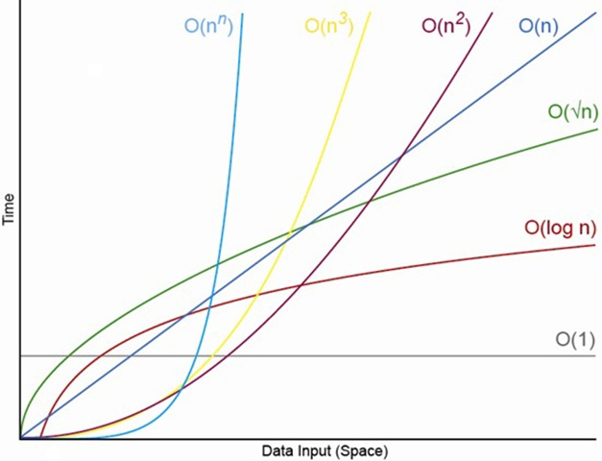
2. Big-O Notation: Common Functions

Slide 14
Topics
Big O Notation
Asymptotic Analysis

